Slide 1
12th Artificial Economics Conference
The Impact of Dividends in an Investor Network
Presented by: Matthew Oldham

Slide 2
Agenda
Motivation for the paper
Theoretical background
The EMH approach
Alternative approaches
Model overview
Results & Conclusions
Questions

Slide 3
Research Motivation
The behavior of financial markets continues to frustrate academics and investors alike
Emerging methods provide alternate approaches
Complex systems/ABMs
Agents adapting and evolving
Networks
Combine the above to provide insight to better explain how financial markets operate

Slide 4
Background
Are markets efficient?
If they are, then returns follow a random walks
The efficient market hypothesis (EMH)
The price is right
No free lunch
The evidence against is mixed
Few have beaten the market BUT
The price may not be right

Slide 5
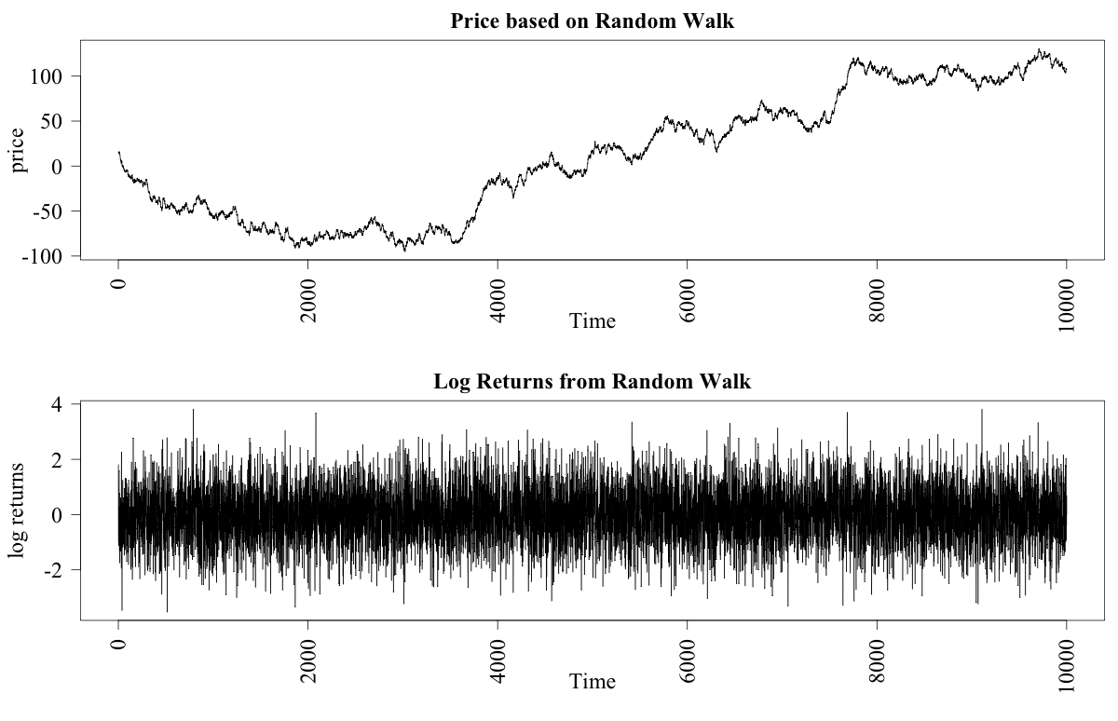
A random walk

Slide 6
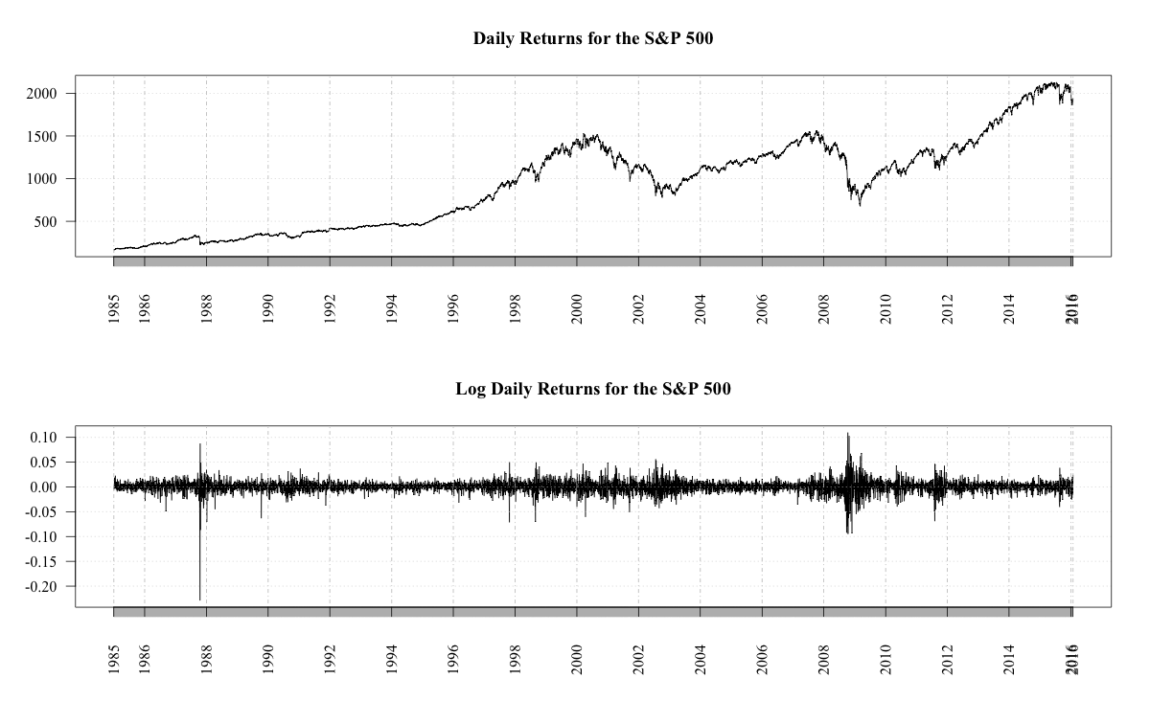

Slide 7
Within EMH - The Price is Right
Goes to the point of rationality
Assets will sell for their intrinsic value
Intrinsic value = Net Present Value of the future cash flows of a company? Dividends provide proxy
Price will not diverge from intrinsic value
How could anyone know that?
Note - this part is not even testable.
Shiller (1980) did produce evidence that this does not hold

Slide 8
Alternative frameworks
If not a representative agent then what?
Amongst others there is possibility of
Complex System
Behavioral Finance
Bounded Rationality
Herding
Why these?
Can analyze via an ABM
Allows for the inclusion of networks

Slide 9
May be there are other ways
Complex system should have most if not all of the following
feedback
non-stationarity
many interacting agents
adaptation
evolution
single realization
open system

Slide 10
Finding a model
The model of Harras & Sornette (2011) met the requirements of the research question. How?
Ising based ABM that produced
Bubbles
Stylized market statistics
Model allowed for:
Networks
Adaption/Evolution
Rationally bounded agents

Slide 11
Breaking down the model
Agents consider three sources of information:
Neighbors’ actions
Public
Private
Develop trust in these sources
Multiple degrees of heterogeneity
Decision threshold
Fixed weightings in trust

Slide 12
Breaking down the model
Fixed values determined by user but heterogeneous for agents
The decision score
Trust – updated at each tick
Information source – new at each tick
i – ith asset k – agent j’s kth neighbor
j – jth agent

Slide 13
The flow of the model
Step 1: Asset information updated
Step 2: Agents assess information sources
Step 3: Agents make investment decision
Step 4: Order book formed
Step 5: Market cleared and asset returns calculated
Step 6: Agents reassess the value of public information
Step 7: Agents reassess the value of their neighbors
Step 8: Agent portfolios updated
Step 9: Portfolio valuation performed

Slide 14
Variations made to the H&S model
Networks
Options expanded beyond lattice
Public information
Added a more realistic process

Slide 15
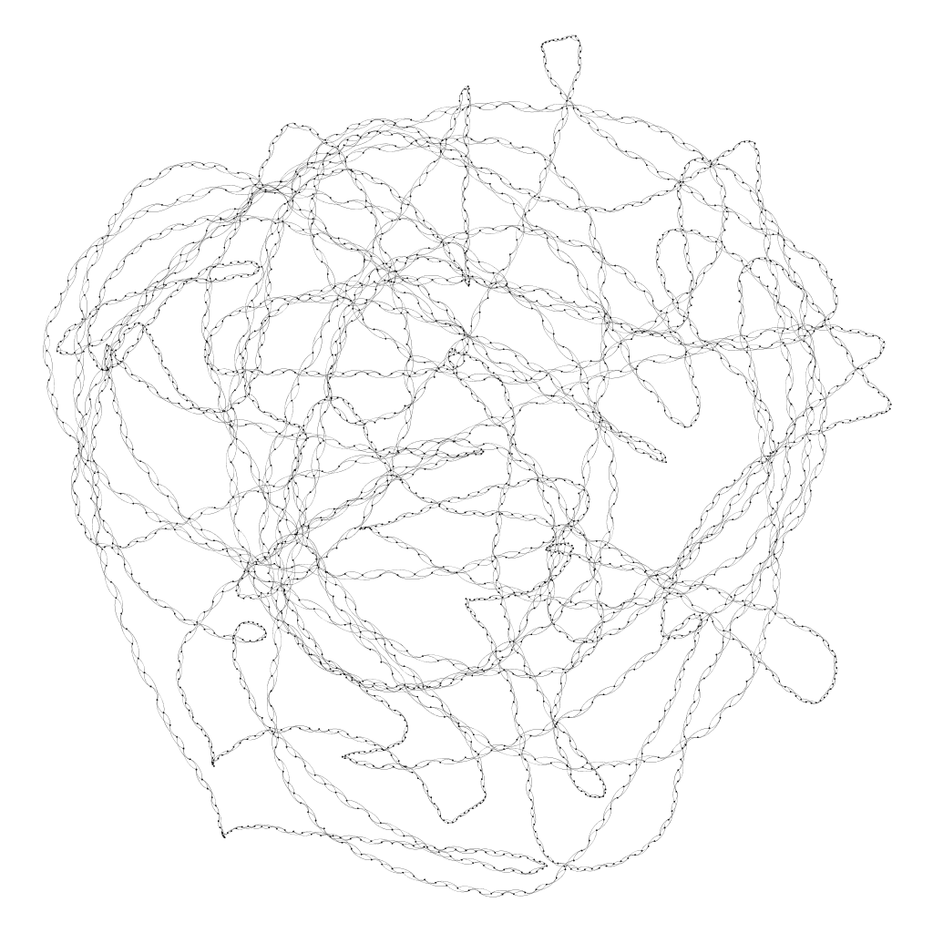
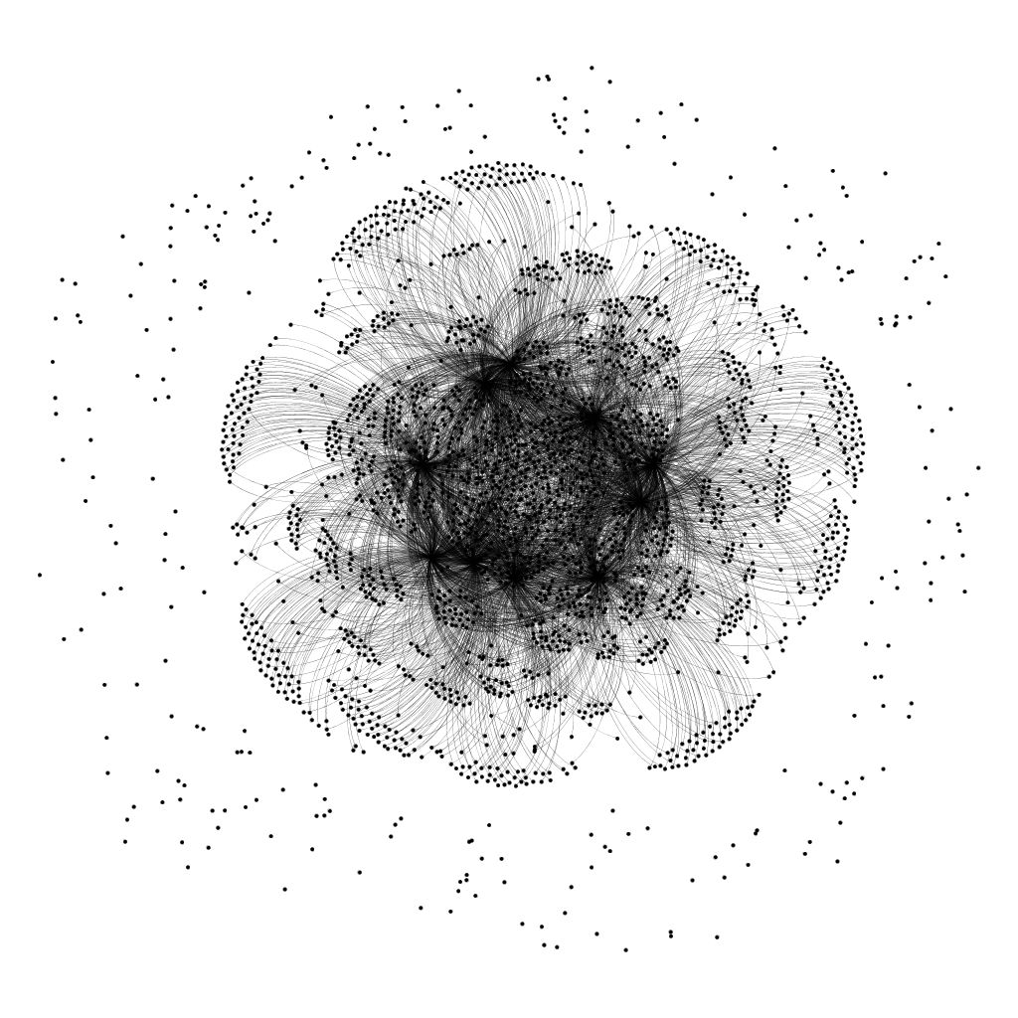
Lattice and scale-free networks

Slide 16
Change to public information
Public information changed to add realism
From N(0,1) -> N((.25/15),.5 *(.25/15))
Earnings per share (EPS) earnings capacity of a company
Consensus forecast => provides expectations
Add a dividends as they important
42% of returns for the S&P (Ro 2013)
Agents compare expectations with actual EPS

Slide 17
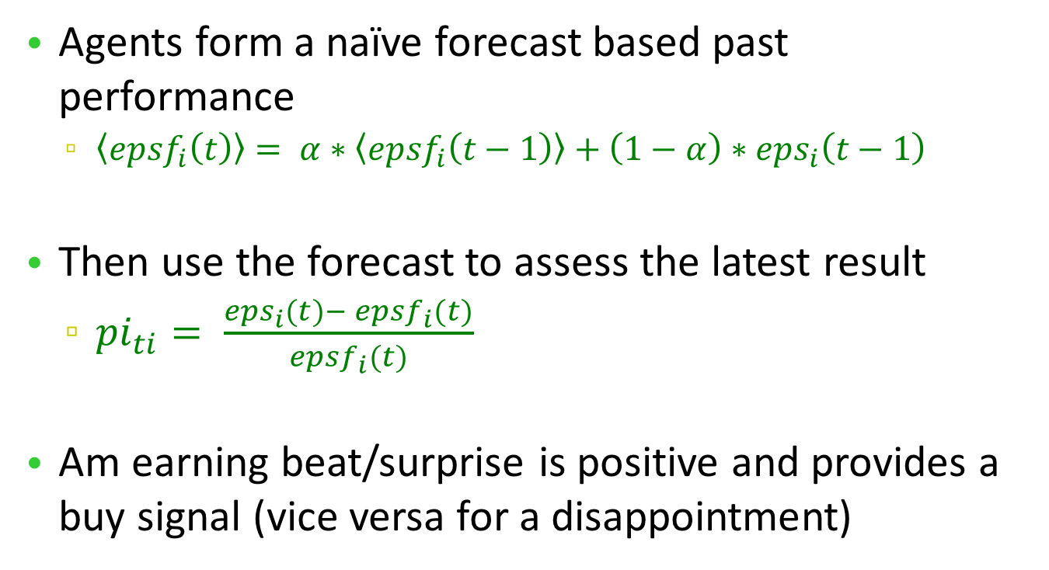
Earning surprise/disappointment
Agents form a naïve forecast based past performance
$〈{epsf}_{i}\left(t\right)〉= α∗〈{epsf}_{i}\left(t−1\right)〉+\left(1−α\right)∗{eps}_{i}\left(t−1\right)$
Then use the forecast to assess the latest result
${pi}_{ti}= \frac{{eps}_{i}(t)− {epsf}_{i}(t)}{{epsf}_{i}(t)}$
Am earning beat/surprise is positive and provides a buy signal (vice versa for a disappointment)

Slide 18
The Australian Example
Company | Dividend Policy
AMP | Payout ratio – 70-90% of underlying profit
BHP | Minimum 50% payout
QBE | Maximum payout of 65% of annual cash profits
Woodside | Payout ratio – 70-90% of underlying profit
Westpac vs ANZ | Seeks to consistently lift their ordinary dividend vs 60-65% of cash earnings
Payout ratios typically the accepted policy

Slide 19
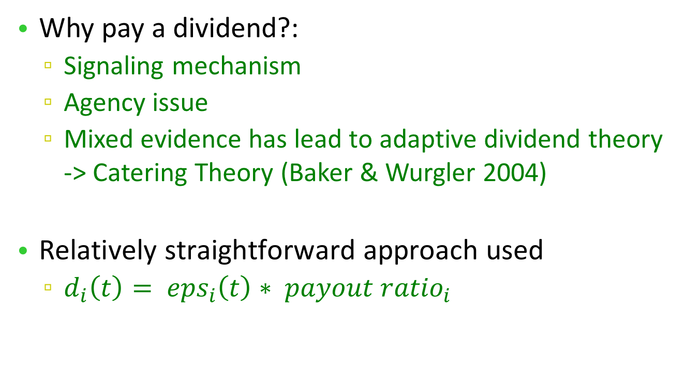
The dividend mechanism
Why pay a dividend?:
Signaling mechanism
Agency issue
Mixed evidence has lead to adaptive dividend theory -> Catering Theory (Baker & Wurgler 2004)
$\text{Relatively} \text{straightforward} \text{approach} \text{used}$
$d_{i}\left(t\right)= {eps}_{i}\left(t\right)∗ {payout ratio}_{i}$

Slide 20
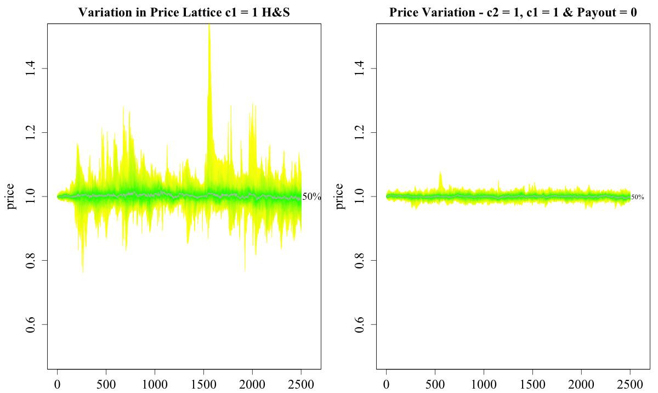
Revised model vs. the base H&S
No bubbles with a tighter range but
Returns are not normally distributed

Slide 21
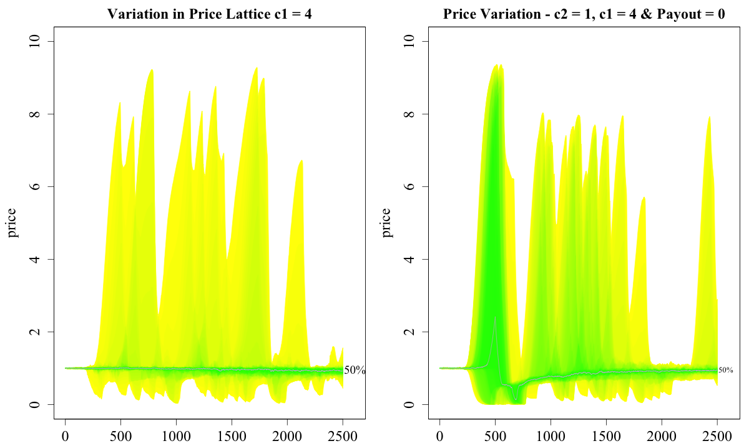
Revised model vs. the bubble H&S
Bubbles created

Slide 22
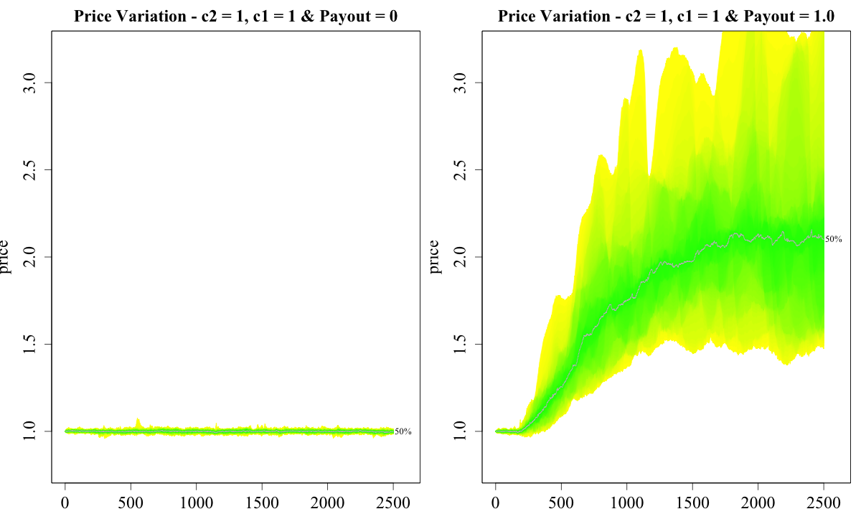
The effect of adding a dividend
100% payout sees
Median price maintained well above fundamental value
Greater volatility

Slide 23
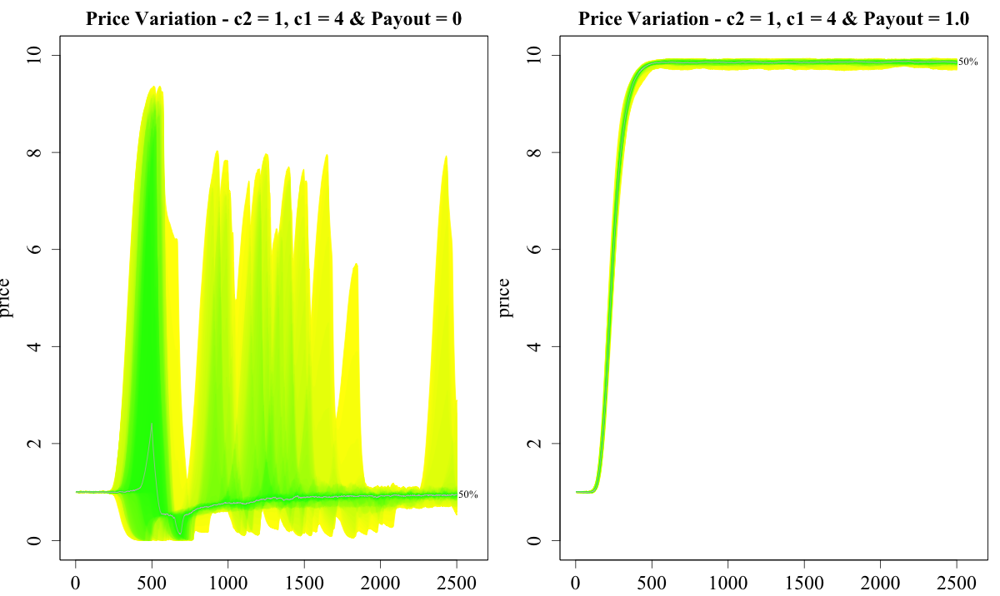
The effect of adding a dividend
System can sustain a bubble with high initial bias to your neighbors and payout provides self filling prophecy

Slide 24
The impact of a scale-free network
Bubble created even without dividend when c1 = 4
The volatility is much higher
Median price maintained well above fundamental value

Slide 25
The impact of a scale-free network
Initial bubble is marginally higher
There is a drifting down in the median price not seen in the lattice network

Slide 26
How does it happen?
Network trust is maintained at a higher level
When EPS > 0 returns will be higher
Trust update will be amplified
Everyone locks into wanting to buy
Dividends stops the bubble popping
Scaling Factor

Slide 27
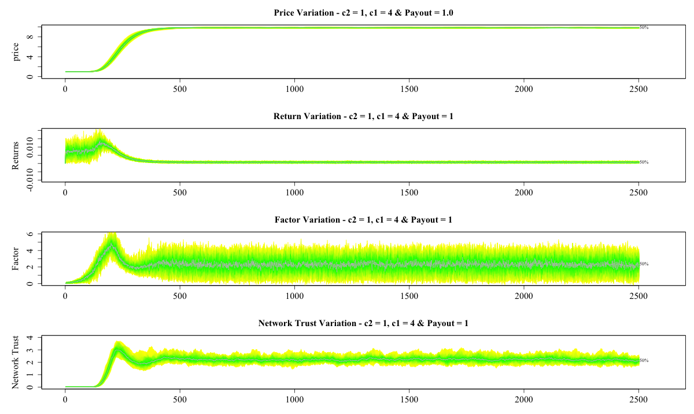
Returns higher but mixed early on
The higher factor level drives the growth in trust
Trust grows, declines but does not pop

Slide 28
Implication
Dividends matter
Impacted dampened if fundamental analysis remains
Management needs to be aware of their investor network though
This goes against Miller and Modigliani (1961)
What would happen if payout ratio fell today?
South Sea bubble provides an example of what happens when the dividends stop - collapse

Slide 29
Summary
Further areas
Further dynamics
Selection of neighbors
Firm’s actions:
Dividend policy
Capital expenditure planning
Agent level analysis
Wealth is relation to risk aversion and position in the network

Slide 30
Questions

Slide 31
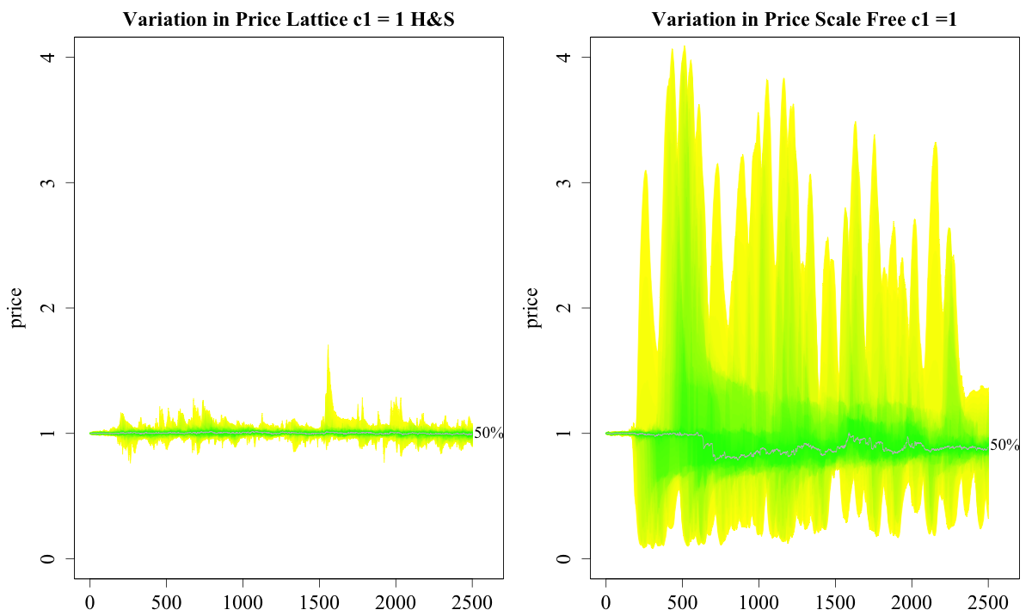
The impact of different networks
Scale free is very different. Does not need high level of c1.
Lattice not dissimilar to ER and SW when c1 = 1

Slide 32
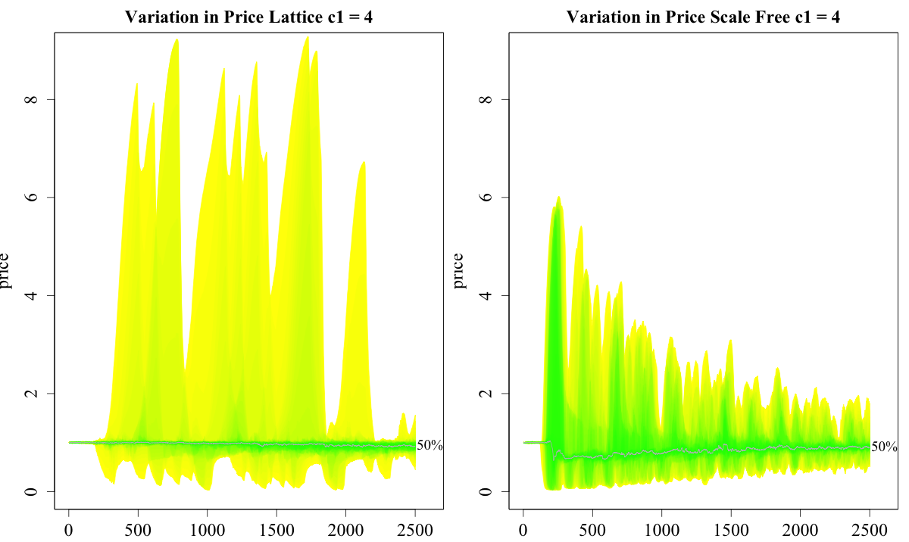
The impact of different networks
See very different behavior
Peak not as high for SF
Greater isolation
Median price drops below 1

